Slide 1

Chapter 9
Sessions and Authentication

Slide 2

Objectives
This chapter begins with a brief introduction to middleware before delving into the concepts of authentication models and session engines.
You will implement Django's authentication model to restrict permissions to only a specific set of users.
You will see how you can leverage Django authentication to provide a flexible approach to application security.

Slide 3
Session concepts
• A session is a way to store information (in variables) to be used across multiple pages.
•To store the data for each session, the server creates a session object.
•session object contains session ID and other information that are stored in attributes.

Slide 4
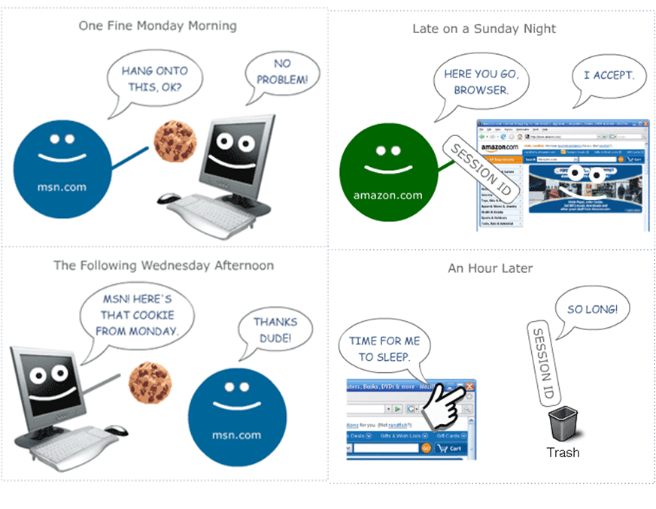
Session concepts

Slide 5
Enabling Sessions
To enable sessions, you’ll need to follow these steps:
Edit your MIDDLEWARE_CLASSES setting and make sure MIDDLEWARE_CLASSES contains 'django.contrib.sessions.middleware.SessionMiddleware'.
Make sure 'django.contrib.sessions' is in your INSTALLED_APPS setting (and run manage.py syncdb if you have to add it)

Slide 6
Using Sessions in Views
When SessionMiddleware is activated, each HttpRequest object – the first argument to any Django view function – will have a session attribute, which is a dictionary-like object.

Slide 7
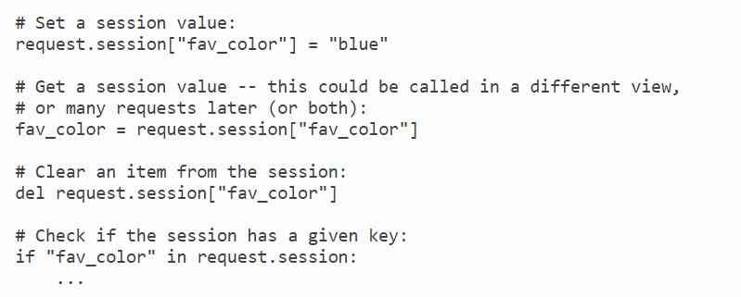
Using Sessions in Views

Slide 8
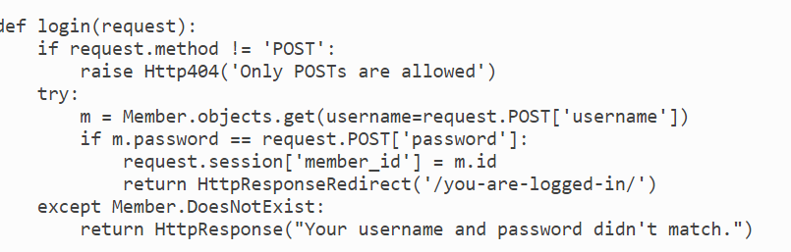
Example Sessions

Slide 9
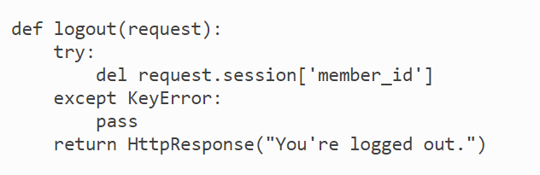
Example Sessions

Slide 10
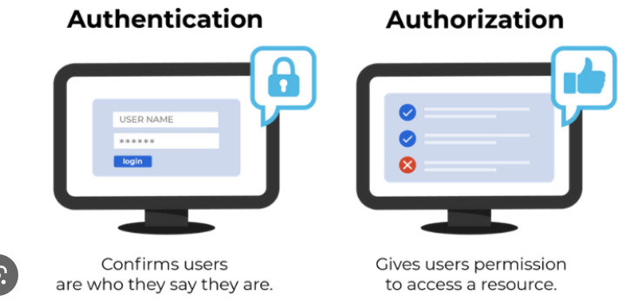
Users and Authentication

Slide 11
Enabling Authentication Support
1. Make sure the session framework is installed as described earlier in this chapter. Keeping track of users obviously requires cookies, and thus builds on the session framework

Slide 12
Enabling Authentication Support
2. Put 'django.contrib.auth' in your INSTALLED_APPS setting and run manage.py syncdb to install the appropriate database tables.

Slide 13
Enabling Authentication Support
3. Make sure that 'django.contrib.auth.middleware.AuthenticationMiddleware' is in your MIDDLEWARE_CLASSES setting – after SessionMiddleware.

Slide 14
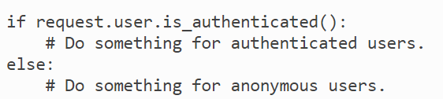
Enabling Authentication Support
You can easily tell if a user is logged in with the is_authenticated() method:

Slide 15
Summary
We have examined Django's middleware implementation of authentication and sessions.
We have learned how to incorporate authentication and permission logic into views and templates.
We can set permissions on specific pages and limit their access to authenticated users.

